Slide 1

Consolidated Annual Performance Evaluation Report (CAPER)
Housing and Community Development Division
Report Overview & Invitation for Public Comment
September 15, 2022
Notes:
Hello and welcome to the virtual webinar for the Consolidated Annual Performance Evaluation Report, also known as the CAPER, presented by the City of Fresno Housing & Community Development Division.
In this presentation, we will provide an overview of the report, and provide information regarding how the public can submit comments.

Slide 2
Contents
HUD CPD Programs & the CAPER Overview
2021-2022 Accomplishments
Affordable Housing
Homelessness
Community Services
Public Facilities & Public Improvements
Fair Housing
Invitation for Public Comment
Notes:
First, we’ll briefly discuss the U.S. Department of Housing and Community Development Community Planning and Development programs and the role of the CAPER. Then, we’ll review the accomplishments reported in the CAPER by priority area, including Affordable Housing, Homelessness, Community Services, and Public Facilities and Public Improvements. The CAPER also reports on Fair Housing activities, so we’ll discuss accomplishments in that category as well. Finally, we’ll provide information about how the public can comment on the CAPER.

Slide 3
HUD CPD Programs & the CAPER
Notes:
First, what is a HUD CPD program? What is the CAPER? We’ll explain in this section.

Slide 4
HUD Community Planning & Development
U.S. Department of Housing and Urban Development, Office of Community Planning and Development (HUD CPD) seeks to:
Develop viable communities for low and moderate income people.
Decent housing
Suitable living environment
Economic opportunities
Notes:
HUD CPD is the U.S. Department of Housing and Urban Development’s Community Planning and Development office. The Office of Community Planning and Development (CPD) seeks to develop viable communities by promoting integrated approaches that provide decent housing, a suitable living environment, and expand economic opportunities for low and moderate income people. The primary means towards this end is the development of partnerships among all levels of government and the private sector, including for-profit and non-profit organizations. In the next slides, we’ll talk about how the City partners with HUD CPD to help meet these goals.

Slide 5



Before the Program Year
HUD CPD provides funds to the City
CDBG  HOME  ESG  HOPWA
The City prepares its goals in an Annual Action Plan after consulting with residents
City Divisions &
Sub-Recipients
The City approves project activities and provides funding for city divisions and community organizations
Notes:
Before every program year, HUD CPD announces the funding that will be made available to the City through the four programs in which the City participates: the Community Develop Block Grant, or CDBG; HOME Investment Partnerships, or HOME; Emergency Solutions Grant, or ESG, and Housing Opportunities for people with HIV/AIDS, or HOPWA. These four programs each make funding available for different eligible activities, but overall seek to meet the national objective of providing benefit to low- and moderate-income people.
Next, the City prepares its goals in an Annual Action Plan, in consultation with residents regarding the most critical needs in the community. The Annual Action Plan also needs to be consistent with the goals and priorities that the City adopted through a 5-year consolidated plan.
Once the Annual Action Plan is approved by City Council and submitted to HUD, the City implements the projects, programs, and activities in the plan by either providing funding and technical assistance to City divisions or to non-profit organization sub-recipients which are awarded funding after an application process. Those City divisions and non-profit sub-recipients then perform the activities throughout the year. Later in this presentation, you’ll be introduced to the activities that were performed during the 2021-2022 program year.

Slide 6
After the Program Year
HUD CPD accepts the CAPER and the City continues to be eligible to receive funds
The City prepares the CAPER, to tell HUD CPD and residents how funds were used to meet the Annual Action Plan goals
City Divisions &
Sub-Recipients
City divisions and sub-recipients report their accomplishments to the City
Notes:
Throughout the program year, and especially at the end of the program year, the City divisions and non-profit sub-recipients who received funding report how they spent their HUD CPD funds, and their accomplishments, to the City.
The City then collects all of the information into a single performance report, called the CAPER. The City Council approves the CAPER after the public has been invited to comment on it. This public opportunity to review and comment is not only required by HUD, it’s also an important step for the City to make sure that its activities are transparent and that it’s continuously listening to the needs of the community in order to improve future plans and activities.
Once the City Council has approved the CAPER, the report is submitted to HUD. Submitting the CAPER is a requirement for the City to continue to receive funding.

Slide 7
2021-2022 CAPER
July 1, 2021 through June 30, 2022
Only actual activities and actual expenses recorded during this time frame are reported
Many activities are multi-year projects, in which case their accomplishments will usually only be reported in the final year
Notes:
The Program Year 2021 CAPER reports on the expenses and accomplishments recorded between July 1, 2021 and June 30, 2022. Many activities are multi-year projects, in which case their accomplishments will usually only be reported in the final year. There are some exceptions to this rule, such as for community service activities, which will report accomplishments as they occur.

Slide 8
2021-2022 CAPER
Expenditures Reported in the CAPER:
Source of Funds | Amount Expended
Community Development Block Grant (CDBG) | $3,691,775
HOME Investment Partnerships (HOME) | $251,134
Emergency Solutions Grant (ESG) | $735,327
Housing Opportunities for people with AIDS/HIV (HOPWA) | $573,552
Notes:
During the course of the program year, approximately $5.25 million was expended to administer and perform activities. This included approximately 3.6 million dollars in CDBG funds, 251 thousand in HOME funds, 735 thousand dollars in ESG funds, and 573 thousand dollars in HOPWA funds.

Slide 9
2021-2022 CAPER
Accomplishments
Accomplishments are typically reported as the number of people assisted or the number of affordable housing units
Accomplishments are presented according to which plan priority they supported
Affordable Housing
Homelessness
Community Services
Public Facilities and Public Improvements
Fair Housing
Notes:
The Accomplishments reported in the CAPER are typically reported as the number of people assisted or the number of affordable housing units constructed or rehabilitated. The accomplishments in the report are grouped by the priority area they fall under – these priorities were determined in consultation with the community in the City’s 5-year Consolidated Plan. The priorities for the 2021 CAPER are Affordable Housing, Homelessness, Community Services, and Public Facilities and Public Improvements. The CAPER is also used by the City to report its efforts in removing the barriers to fair housing identified in another required HUD report called the Analysis of Impediments to Fair Housing Choice. In the next section, we’ll go over the accomplishments in each of these priority areas for the 2021 Program Year.

Slide 10
2021-2022 Accomplishments
Notes:
We’ll now review the accomplishments reported in the CAPER from July 1, 2021 through June 30, 2022.

Slide 11
Priority: Affordable Housing
Increase development, preservation, and rehabilitation of affordable housing for low‐income and special needs households.
2021-2022 Goal | Expected | Actual
Homeowner Housing Added | 2 | 4
Homeowner Housing Rehabilitated | 71 | 43
Rental Units Constructed | 24 | 0
Notes:
The first priority we’ll talk about today is Affordable Housing. Our goal for Affordable Housing is to increase development, preservation, and rehabilitation of homes for people with low-incomes or special needs.
Over the course of the year, we were able to add four new homes and rehabilitate 43 homes in the city.
Unfortunately, due to delays in Section 106 reviews, increased material costs, and shortages due to the COVID-19 pandemic, the City experienced overall delays on some projects. During the 2021-2022 Program Year, the City made progress toward completing additional rental units, but it wasn’t able to complete any of them. However, these units will be counted in future CAPERs once construction is completed. In these next slides, we’ll tell you about some of the projects we’re working on and the homes we added.

Slide 12
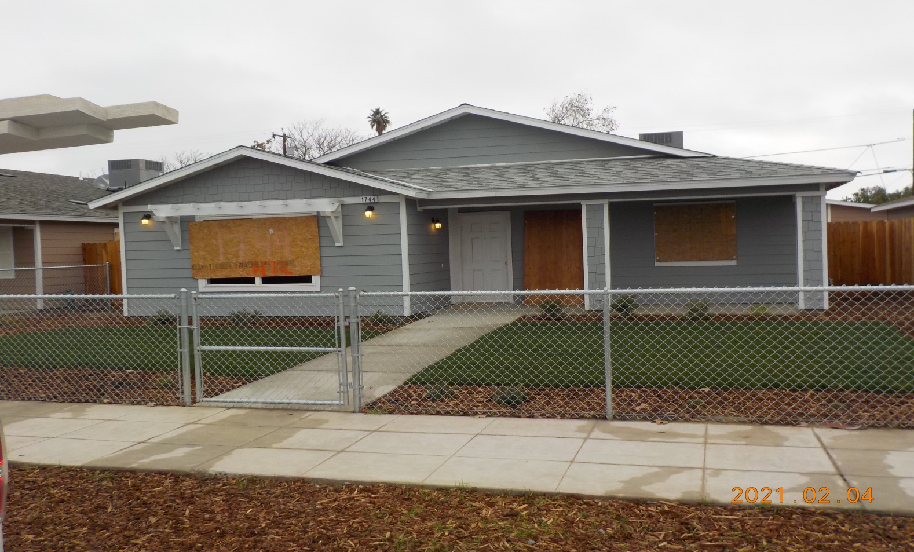

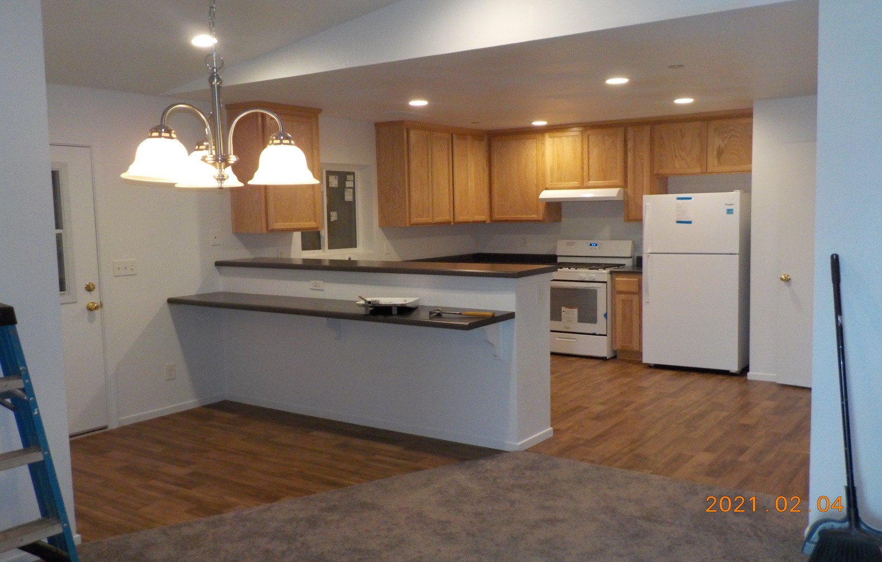
New Affordable Housing
B and Amador Project
Habitat for Humanity 4 homes
Notes:
Through our partnership with Habitat for Humanity, we were able to add 4 5-bedroom, 2-bathroom single-family homes in the southwest area that will be sold to low-income homebuyers. The B and Amador Project used a total of $1.3 million in HOME Community Housing Development funds which included $580,263 from the 2021-2022 Program Year.

Slide 13

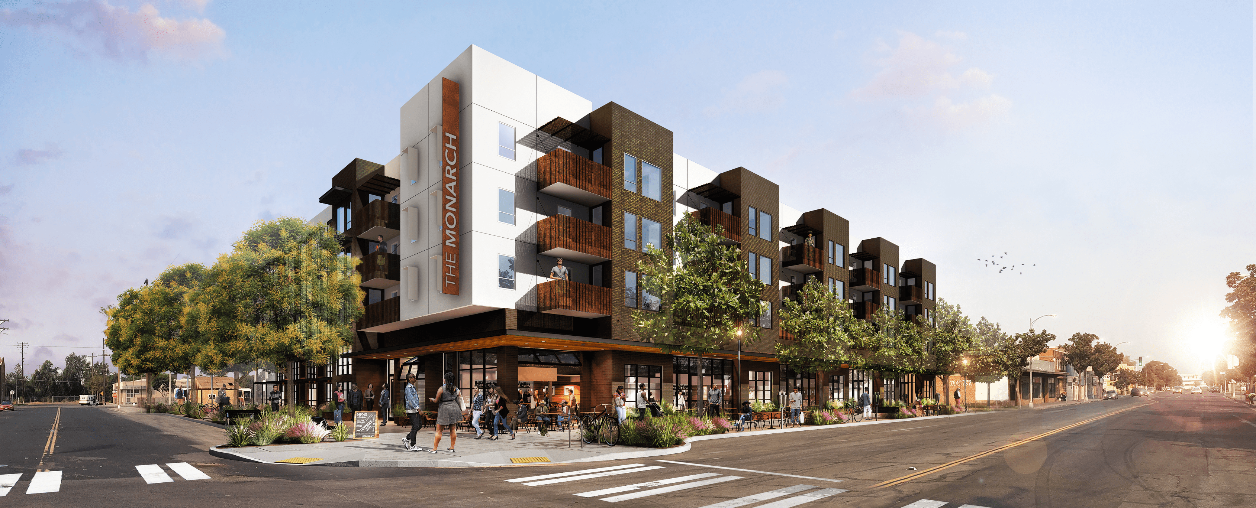

Affordable Housing Development Underway
Annadale Phase II
S-F Housing Project Self-Help Enterprises 22 homes
Monarch at Chinatown Project Fresno Housing Authority 57 apartments
Notes:
In addition to the 4 units completed by June 30, 2022, several projects were underway during the program year including:
The second phase of Self-Help Enterprise's Annadale Single-Family Housing Project which will consist of new construction of 22 homes in the southwest area.
Fresno Housing Authority is working on its Monarch at Chinatown Project which consists of new construction of 57 apartments in the downtown area.

Slide 14
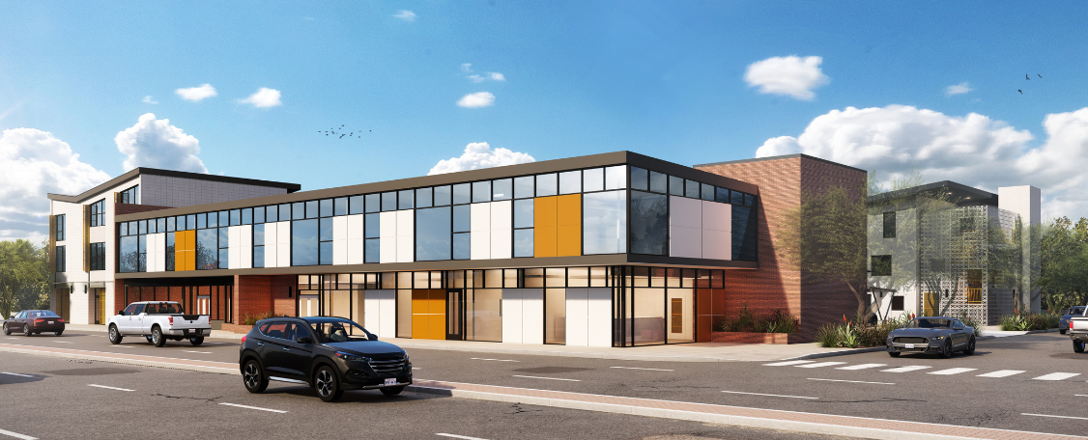
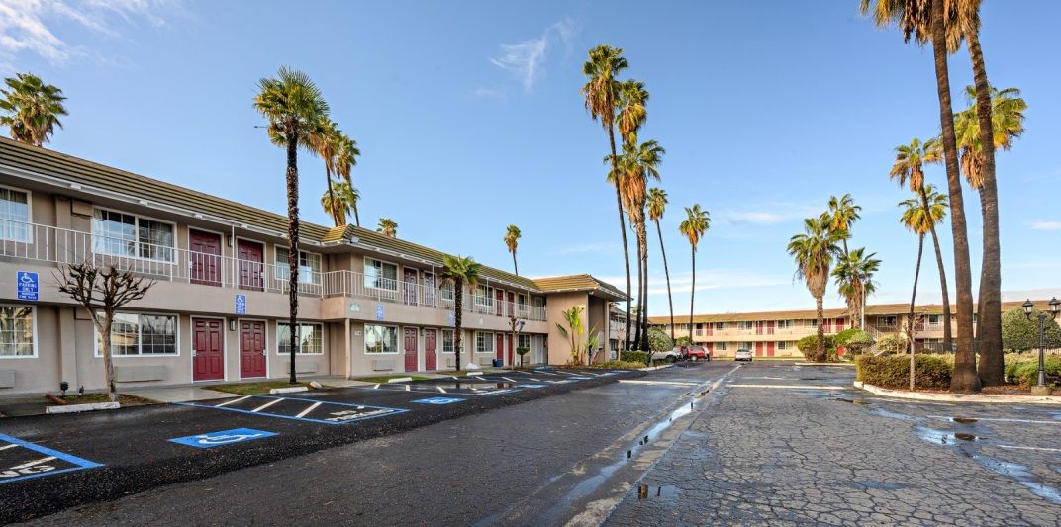
Affordable Housing Development Underway
Walnut - Florence -Plumas Project
17 homes
The Arthur at
Blackstone 41 apartments
Sun Lodge
64 apartments
Notes:
The Walnut-Florence-Plumas Project from Self-Help Enterprises will develop a subdivision of 17 affordable homes in southwest Fresno.
The Fresno Housing Authority is working on two projects: The Arthur at Blackstone, and Sun Lodge. The Arthur will add 41 apartments in the Shields and Blackstone area.
Through the Sun Lodge Project, the Housing Authority will be renovating, and adding to, the old Day’s Inn motel to provide 64 more affordable apartments in the Olive and 99 area.

Slide 15
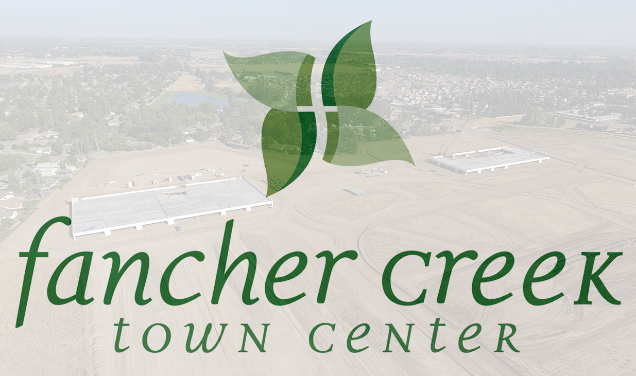
Affordable Housing Development Underway
Barcus and Rialto
Single-Family Housing 2 homes
Brand Haven Senior Housing Project
180 units
Notes:
Habitat for Humanity’s Barcus and Rialto Single-Family Housing Project consists of new construction of two 3-bedroom/2-bathroom homes, attached garage, and on-and off-site improvements.
Fancher Creek Town Center’s Brand Haven Senior Housing Project consists of new construction of 180 multi-family senior housing units and on- and off-site improvements.

Slide 16
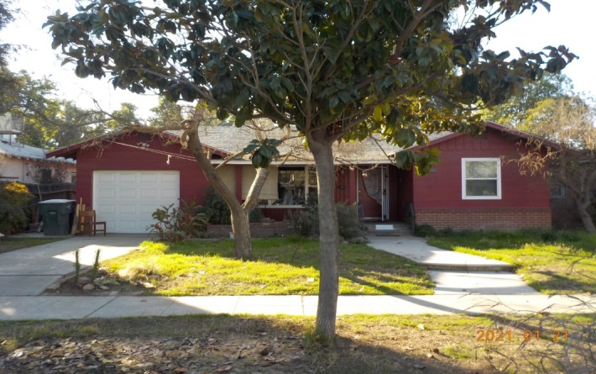
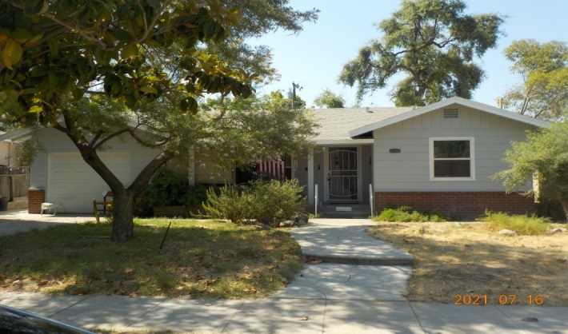
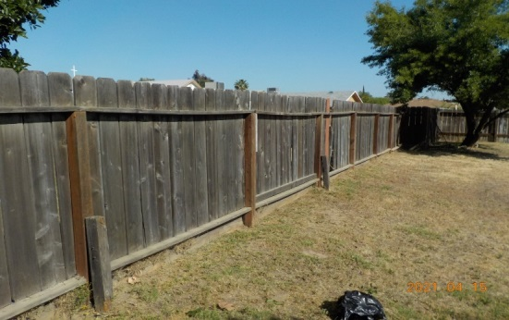
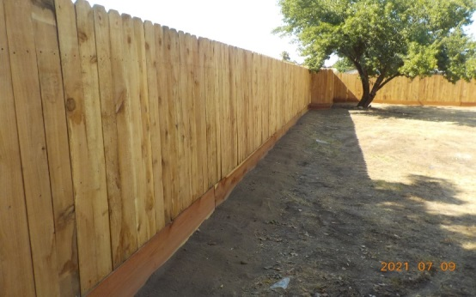


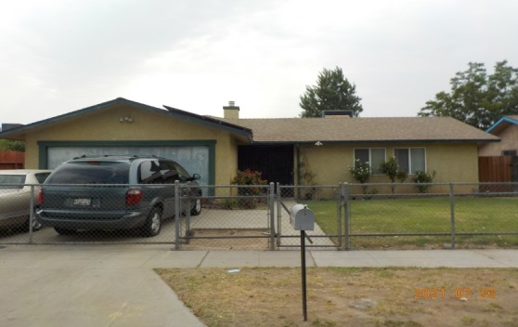
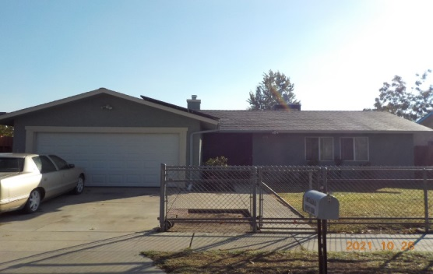
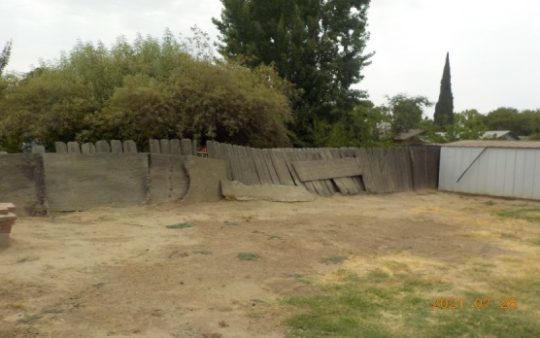
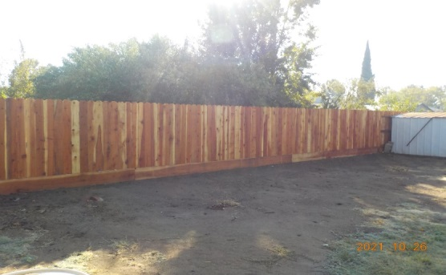
Housing Rehabilitation
Senior Paint Program
18 completed
Home Repair and Rehabilitation Program
17 completed
Housing Rehabilitation/Repair Program
8 completed
Notes:
The City, and its partners Self-Help Enterprises and Habitat for Humanity, were able to renovate 43 homes last year.
Occasionally, some of these homes have a historical value to the community which may result in them being subject to Section 106 of the National Historic Preservation Act. Unfortunately, due to delays in Section 106 reviews, increased material costs, and shortages due to the COVID-19 pandemic, the City experienced delays on some projects. While we are proud of what we, and our partners, were able to accomplish last year, we anticipate seeing improvements in these numbers over the next couple of years.

Slide 17
Priority: Homeless Prevention
Provide assistance to those experiencing homelessness or are at-risk of experiencing homelessness
2021-2022 Goal | Expected | Actual
Public Service Activities | 167 | 2,255
Tenant-Based Rental Assistance/Rapid Rehousing | 122 | 207
Overnight Shelter | 581 | 1,071
Notes:
Three goals were associated with the prevention of homelessness in the City. In spite of Program Year 2021 being an especially challenging time to provide services and outreach, the City greatly exceeded all of its goals for the year.
Next, we’ll go through some of the accomplishments made using the five grants available to the City to help people experiencing homelessness.

Slide 18

Community Development Block Grant (CDBG)
Domestic Violence Survivor Safe Housing
108 survivors assisted
Notes:
Through the Community Development Block Grant, the City partnered up with the Marjaree Mason Center to provide safe housing for 108 survivors of domestic violence.

Slide 19


Emergency Solutions Grant (ESG)
Homeless Prevention
17 people assisted
Rapid Rehousing 121 people assisted
Emergency Shelter 963 people assisted
Street Outreach
1,628 people assisted
Notes:
Through the Emergency Solutions Grant, the City partnered up with the Marjaree Mason Center, WestCare California, and the Poverello House to provide homeless prevention services, rapid rehousing, emergency shelter, and street outreach. In total, 2,729 homeless and at-risk people were served in PY 2021 through ESG.

Slide 20
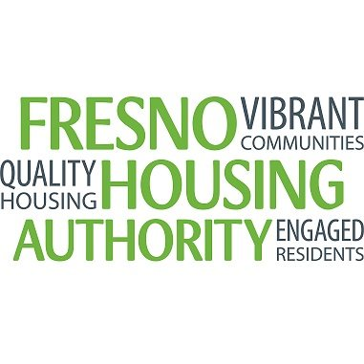
HOME Investment Partnerships (HOME)
HOME Tenant-Based Rental Assistance Program
12 people assisted
Notes:
Tenant-based rental assistance programs, often referred to as TBRA, subsidize private market units for homeless and low-income households to increase affordability.
During the Program Year, the Fresno Housing Authority used HOME funds to assist 12 homeless and at-risk people.

Slide 21
Housing Opportunities for People with AIDS (HOPWA)
Rapid Rehousing; Short-term Rent, Mortgage, and Utility Assistance; Tenant-Based Rental Assistance; or Housing through Short-term or Transitional Facilities
74 people assisted
Supportive Services; Referral and Housing Services; or Non-Housing Services
610 people assisted
Notes:
WestCare California assisted 684 people and families with referrals to housing and non-housing services; rapid rehousing; short-term rent, mortgage and utility assistance; tenant-based rental assistance; and other supportive services throughout Program Year 2021 using HOPWA funds.

Slide 22
Priority: Public Infrastructure and Facilities
Provide public infrastructure and facilities improvements to strengthen neighborhood revitalization.
2021-2022 Goal | Expected | Actual
Public Facility or Infrastructure Activities | 10,000 | 72,873
Notes:
Another goal for Planning Year 2021 was to improve public infrastructure and facilities, and the City was able to exceed that goal by more than 725 percent.
Public facility or infrastructure improvements reports the number of individuals who reside in the service area of a completed public facility or infrastructure improvement which was improved using CDBG funds during the program year. Unlike other activities, this is considered an ‘area’ benefit, which means that every individual who resides within the service area designated to receive a benefit from the improvement is counted in the total.

Slide 23
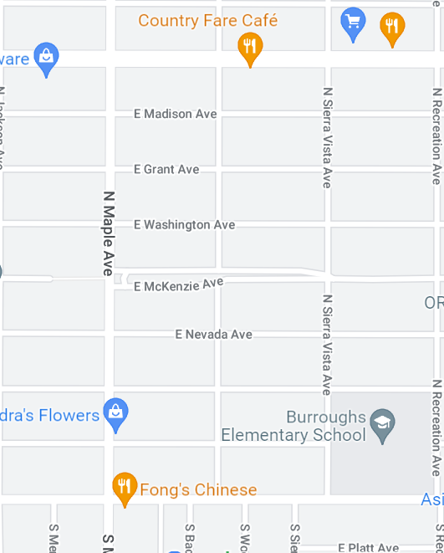
Street Improvements
Burroughs Elementary Neighborhood Street Reconstruction – Phase One
City of Fresno Public Works Department
6,740 people
Notes:
The City of Fresno Public Works Department completed two roadway reconstruction projects using CDBG funds during Program Year 2021. The first project benefitted 6,740 people in the Burroughs Elementary Neighborhood.

Slide 24
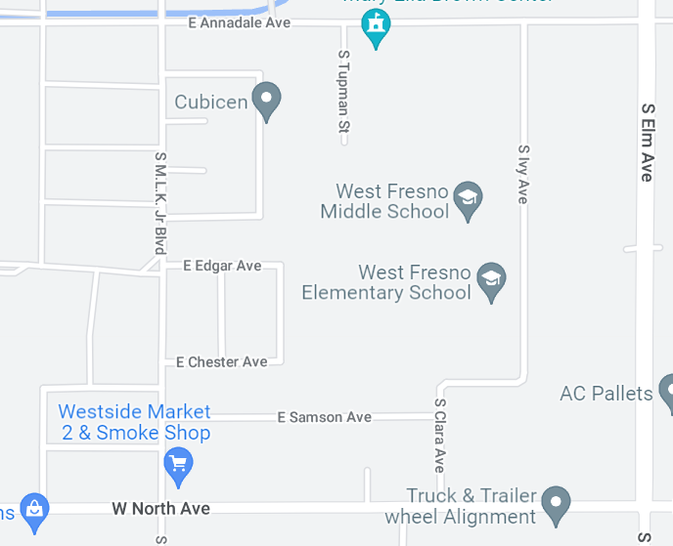
Street Improvements
West Fresno Elementary & MLK Neighborhood Street Improvements City of Fresno Public Works Department 3,665 people
Notes:
The second roadway reconstruction project completed by the City of Fresno Public Works Department benefitted 3,665 people in the West Fresno Elementary and MLK Neighborhood.

Slide 25
Additional Public Facilities and Public Improvements Underway
The Webster Community Canal Barricade
The Burroughs Elementary Neighborhood Street Reconstruction – Phase II
The Ivy-Annadale to Chester Neighborhood Street Improvements
The Ericson Elementary Neighborhood Street Reconstruction
The Highway City Neighborhood Street Reconstruction
The Yosemite Middle School Complete Streets Design
The Maple-Gettysburg-Holland Street Reconstruction
The Olive-Maple-Whitney-Chestnut Street Reconstruction
The Shields-Cedar-Dakota-Maple Street Reconstruction
Notes:
Several additional public facilities and public improvement projects have received funding or are currently underway – accomplishments for these projects will be reported in the CAPER for the program year in which they are completed. Projects underway include:
The Webster Community Canal Barricade
The Burroughs Elementary Neighborhood Street Reconstruction – Phase II
The Ivy-Annadale to Chester Neighborhood Street Improvements
The Ericson Elementary Neighborhood Street Reconstruction
The Highway City Neighborhood Street Reconstruction
The Yosemite Middle School Complete Streets Design
The Maple-Gettysburg-Holland Street Reconstruction
The Olive-Maple-Whitney-Chestnut Street Reconstruction
The Shields-Cedar-Dakota-Maple Street Reconstruction

Slide 26

Park Facilities Improvements
Learner Pool Designs City of Fresno PARCS Department 20,175 people
Cary Park Lighting Improvements City of Fresno PARCS Department 3,700 people
Romain Challenger Course Improvements City of Fresno PARCS Department 6,740 people
Ted C. Wills Park Improvements City of Fresno PARCS Department 12,710 people
Notes:
The City of Fresno PARCS Department completed seven park improvements during the program year using CDBG funds.
The PARCS Department entered into an agreement with a design firm to address ADA and health department concerns with the learner pools at several city park locations. The City was able to use the plans for the Quigley Learner Pool, Pinedale Learner Pool, and Fink White Leaner Pool activities, in order to complete necessary repairs in order for the pools to reopen to the public, benefiting 20,175 people.
At Cary Park the City installed new light poles at two soccer fields. The new lighting can be accessed remotely and has improved directional lighting that eliminates light pollution into the surrounding neighborhood. The project benefited 3,700 people.
At Romain Park, the City installed a new challenger course which benefited 6,740 people, and at Ted C. Wills Park, we replaced the HVAC system, stained and resealed the recreation room concrete flooring, installed a shade structure over the tot lot, replaced the wheelchair lift in the gym, sanded and resurfaced the wood gym flooring, and replaced the existing bleachers with units that are ADA compatible. 12,710 people benefited from this project.

Slide 27
Park Facilities Improvements
Pinedale Park Improvement City of Fresno PARCS Department 1,590 people
Pinedale Learner Pool City of Fresno PARCS Department 4,688 people
Quigley Learner Pool City of Fresno PARCS Department 12,865 people
Notes:
The PARCS Department make upgrades to the concrete and renovated the indoor and outdoor restrooms. They also made health and safety improvements including upgrades for ADA compliance. 1,590 people benefited from the project.
Much needed repairs were made at the learner pools at Quigley Park and the Pinedale Community Center location in order to make it Health Department compliant and allow it to reopen to the public. The Quigley Park repairs benefited 12,865 people, and the Pinedale Community Center repairs benfitted 4,688 people.

Slide 28
Additional Park Facility Improvements Underway
Fink-White Learner Pool
Frank H. Ball ADA Improvements
Maxie L. Parks HVAC Design
Hinton Restroom and Field Lighting
JSK Victoria West Playground and Shade Structure
Dickey Playground Tot Lot Replacement
Fink-White Splash Park
Notes:
Several additional park facility improvement projects have received funding or are currently underway – accomplishments for these projects will be reported in the CAPER for the program year in which they are completed. Projects underway include:
Fink White Learner Pool
Frank H Ball ADA Improvements
Maxie L Parks HVAC Design
Hinton Restroom and Field Lighting
JSK Victoria West Playground and Shade Structure
Dickey Playground Tot Lot replacement
Fink-white Splash Park

Slide 29
Priority: Community Services
Provide assistance to low‐income and special needs households.
2019-2020 Goal | Expected | Actual
Public Service Activities | 2,915 | 1,634
Businesses Assisted | 36 | 35
Notes:
The fourth goal was to provide services for community members who have low incomes or are special needs. For this goal, 2,915 people were expected to benefit, but 1,634 people actually benefitted during the Program Year. The City was also able to assist 35 small businesses although its goal was to serve 36.

Slide 30
PARCS Public Services
PARCS Afterschool Programs
358 kids served
PARCS Senior Program
461 seniors served
Notes:
The City of Fresno currently operates ten Neighborhood Center locations, funded in part by CDBG, which are located throughout the city in low-income areas. These centers are open Monday through Friday and they provide a safe space for at-risk youth to seek mentorship and access to engaging recreational activities. Programming was provided to 358 children and included activities like performing arts classes, nature hikes, a teen leadership program, arts and crafts, sports, homework centers, large group games, character development programs, cooking classes, a healthy snack program, day camps, karate classes, and service oriented projects.
The senior program returned to providing in-person services in July 2021 and offered seniors in the community an opportunity to socialize with others through a variety of recreational activities. The available activities included, but were not limited to, crafts, ceramics, exercise, tai chi, and bingo. The program improved the well-being of more than 400 seniors within the City of Fresno.

Slide 31



Non-Profit Public Services
Afterschool Programs Boys & Girls Clubs of Fresno County 551 kids served
Street Saints Afterschool Program Fresno County Economic Opportunities Commission 106 kids served
Southeast Asian, Slavic, and African Healing Gardens for Elders
Fresno Interdenominational Refugee Ministries
158 seniors served
Notes:
Local non-profit organizations also offered community services using CDBG funding.
The Boys & Girls Club of Fresno County’s afterschool program provided education, job training, and recreation for 551 kids, ages 6-18, at its West Fresno and East Fresno sites.
Fresno Street Saints provided afterschool enrichment to 106 young people through mentorship, homework assistance, recreation, and educational field trips for kids in southwest Fresno.
FIRM provided support for four community gardens located in the City of Fresno an hosted monthly elder gathers for low-income refugee elders, age 62 and older. The gardens helped meet the needs of 158 elders by providing culturally-responsive spaces where they were able to socialize, reduce stress, and increase access to healthy and nutritious foods.

Slide 32


Non-Profit Public Services
Business in a Box
Fresno Area Hispanic Foundation
20 small business owners assisted
Make Time Business School
Chinatown Fresno Foundation
15 small business owners assisted
Notes:
The Fresno Area Hispanic Foundation successfully assisted 20 underserved small businesses within the City of Fresno. Through the Business in a Box program, FAHF helped small business owners overcome challenges like marketing, technology, and financial barriers. Businesses were assisted in developing a strategic plan to increase their online presence by establishing a website, setting up social media accounts, and helping with logo design to help attract more customers. Each business was encouraged to participate in financial trainings, monthly legal webinars, and was provided with more than 40 hours of direct technical assistance by various industry experts. The program allowed businesses to increase revenue and create more jobs.
The commercial neighborhood in the Chinatown area of Fresno consisted primarily of microenterprises that were suffering from a lack of community attention and were in need of assistance to help revitalize the area and the businesses. So the Chinatown Fresno Foundation developed the Make Time Business School to address the specific needs of the businesses in the area, while providing them technical assistance and training workshops. The program helped 15 microenterprises by developing job growth and an overall improved quality of life in the Chinatown area.

Slide 33
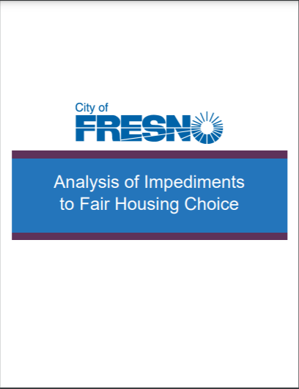
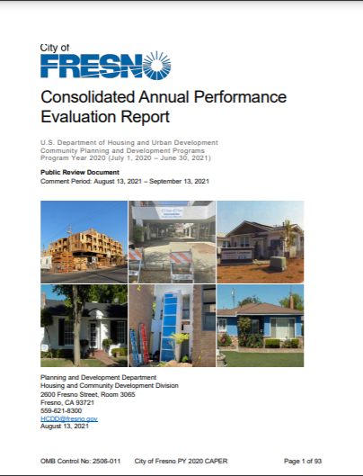
Fair Housing
Recommended Activities to address Private & Public Sector Barriers
Notes:
The City of Fresno is also required by HUD to report on activities in support of Fair Housing. The City updates its Analysis of Impediments to Fair Housing Choice, or AI document, through an analysis and public participation process at least every five years. The most recent update was in 2020. The AI identifies barriers to Fair Housing Choice, and provides recommended activities to address those barriers. The City then reports activities undertaken according to those recommendations in each year’s CAPER report.
A comprehensive summary of the activities undertaken to address each recommendation in the AI is included in CAPER Section CR-35. In this presentation, we’ll provide a few notable highlights. Note that the recommendations of the AI include activities which address overt fair housing issues, as well as activities which address the systemic issues that contribute to barriers to fair housing choice.

Slide 34
Fair Housing Highlights
West Area Neighborhoods Specific Plan
Southeast Development Area Specific Plan
Anti-Displacement Task Force
Here to Stay Report
City Code Updates
Fresno Interdenominational Refugee Ministries (FIRM) Fair Housing Program
Resources for Independence, Central Valley (RICV) Fair Housing Program
Notes:
In the program year, the City started developing the West Area Neighborhoods Specific Plan and the Southeast Development Area Specific Plan along with each of their environmental impact reports. The plans will open the door for residential development in the western and eastern growth areas of Fresno.
The City also partnered with the Thrivance Group to assist with anti-displacement efforts. Through the partnership, the City was able to engage the community by sending 20,000 mailers, hand-delivering 7,500 flyers, making 1,250 phone calls, having 200 face-to-face conversations, conducting 50 interviews, and holding 2 workshops. At the end of the year, the Thrivance Group authored an Anti-Displacement report, and the Planning Department released a companion report entitled Here to Stay: A Policy-Based Blueprint for Displacement Avoidance in Fresno. You can find more information at www.transformfresno.com or at www.fresno.gov/housingelement.
The City also updated some of its ordinances to allow hotels and motels to be converted for residential use, to enable more homes to be built per acre, and to allow for the sale of surplus property to developers (including affordable housing developers).
Our partnership with FIRM make it so we could connect with 3,748 residents to promote Fair Housing. Throughout the year, FIRM conducted 6 webinars, dropped off material at 40 various agencies and organizations, distributed materials during 19 in-person outreach events, made 16 social media posts, performed outreach via e-marketing 10 times, and included Fair Housing information in 3 newsletters.
We also partnered with RICV to provide education in several languages to the community about Fair Housing rights, responsibilities, and regulations through trainings and materials made available through social media, direct mail, the RICV newsletter, and email blasts. RICV also distributed an easy-to-understand booklet to 217 low-income individuals through individual outreach.

Slide 35
Invitation for Public Comment
Notes:
Now I’d like to talk about how you can get involved.

Slide 36
Public Comments Accepted from August 8 – September 8
Submit Comments by Mail:
City of Fresno
Planning and Development Department
Attn: Housing and Community Development Division
2600 Fresno Street Room 3065
Fresno CA 93721
Submit Comments by Email:
HCDD@fresno.gov
Please include “2021 CAPER” in the subject line
Submit Comments by Phone:
559-621-8300
Submit Comments by TTY:
559-621-8721
Submit Comments by Fax:
559-457-1579
Submit Comments Online: https://www.surveymonkey.com/r/5LM339Q
Notes:
If you would like to give a comment about this year’s Report, you have until 8 a.m. on September 8th.
Comments may be submitted by mail to the City of Fresno Planning and Development Department; attn: Housing and Community Development Division; 2600 Fresno Street Room 3065; Fresno CA 93721.
Comments may also be submitted by email to HCDD@fresno.gov. Please include “2021 CAPER” in the subject line.
You may give comments by phone by calling 559-621-8300; by TTY Text Telephone at 559-621-8721; by fax to 559-457-1579; and online by going to the address on the screen.

Slide 37
City Council Public Hearing
City Council Meeting
September 15, 2022
Residents may also comment during a Public Hearing prior to City Council consideration at 10:10 a.m., or thereafter, on September 15, 2022.
Virtual participation instructions will be posted with the agenda at least three business days prior to the City Council meeting, and may be found at fresno.legistar.com/calendar.aspx.
Individuals may request additional accommodations by contacting the office of the City Clerk at (559) 621-7650 or clerk@fresno.gov at least three business days prior to the meeting.
Notes:
Residents may also comment during a Public Hearing prior to City Council consideration at 10:10 a.m., or thereafter, on September 15, 2022.
Virtual participation instructions will be posted with the agenda at least three business days prior to the City Council meeting, and may be found at fresno.legistar.com/calendar.aspx.
You may request additional accommodations by contacting the office of the City Clerk at (559) 621-7650 or clerk@fresno.gov at least three business days prior to the meeting.

Slide 38
View the CAPER at www.fresno.gov/housing.
Notes:
Thank you for taking the time to learn about the City’s Consolidated Annual Performance Evaluation Report for Program Year 2021. To view the report in its entirety, please visit www.fresno.gov/housing.

